Slide 1
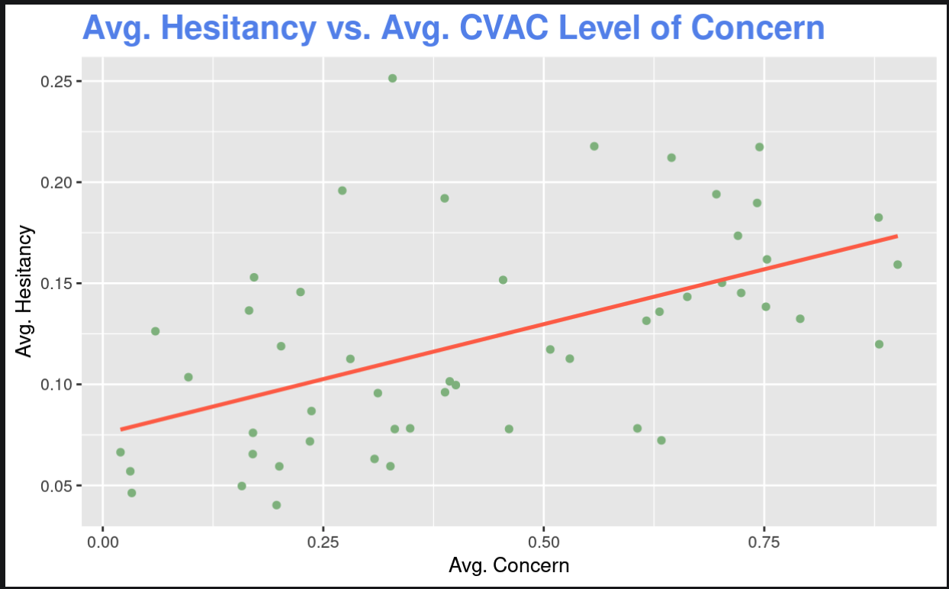
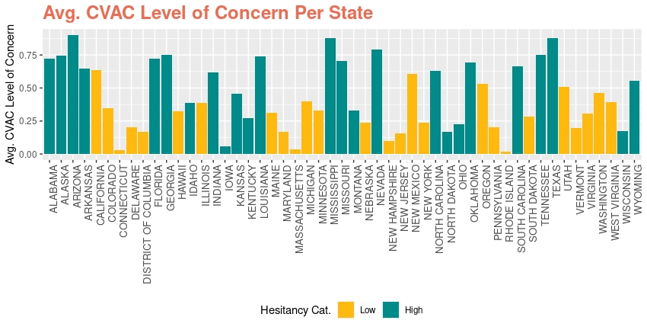
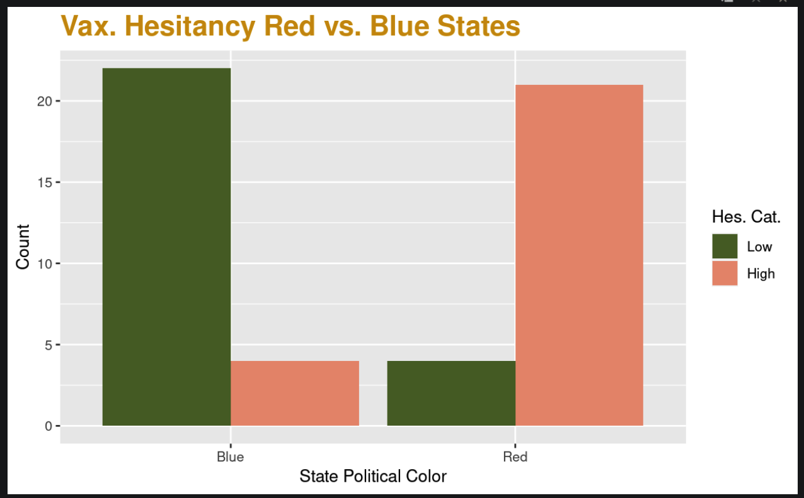
Locational Effects on COVID-19 Vaccine Hesitancy
Mary Ardoin, Lauren Fowler, Johny McGrath
Washington and Lee University
Abstract
Methodology
Results
Discussion & Conclusion
Vaccine hesitancy is a major global health challenge, and factors like the Surgo-COVID-19 Vaccine Coverage (CVAC) index and state politics could significantly affect hesitancy levels. Our research aims to determine whether the average CVAC Level of Concern can predict state-level vaccine hesitancy and examine the impact of a state's political affiliation on its vaccine hesitancy rates. We performed linear regression and Pearson’s chi-square tests on our data regarding vaccine hesitancy rates. Our analysis revealed that higher CVAC levels correlate with increased vaccine hesitancy. Furthermore, Republican states tend to have higher vaccine hesitancy compared to Democratic states, indicating that political orientation significantly influences public health responses. These results underscore the importance of understanding the multifaceted factors behind vaccine hesitancy to devise effective public health interventions and improve vaccine uptake, particularly in regions and demographics identified as high-risk.
Dataset
The dataset used comes from the CDC
The dataset estimates vaccine hesitancy rates at the state level using the U.S’s Census Bureau's Household Pulse Survey and 2019 American Community Survey
The dataset includes variables such as: County, State, Estimated Hesitant, Social Vulnerability Index, CVAC Level of Concern, etc.
Data cleaning
The average estimated hesitancy and CVAC Level of Concern were found for each state.
A new column, State Political Color, was added to the dataset signifying red or blue state using data on how the states voted in the 2020 election.⁶
Testing – Hypothesis 1:
A linear regression was run on average percent vaccine hesitant and average mean CVAC level of concern.
All assumptions were met before running the analysis, including linearity, homoscedasticity, and normally distributed assumptions.
Hypothesis 1:
States that have a higher CVAC Level of Concern have higher rates of vaccine hesitancy.
Average CVAV Level of concern is plotted along the x-axis and average hesitancy is plotted along the y-axis.
A linear regression looking at the association between average percent vaccine hesitancy and average mean CVAC level of concern resulted in a statistically significant positive correlation between the two variables (p<0.001).
As the average CVAC level of concern increases, so does the average percent vaccine hesitancy.
Hypothesis 2:
Republican (red) states will have higher levels of vaccine hesitancy that democratic (blue) states.
State political color is plotted on the x-axis and the count (of states) is plotted on the y-axis. The legend shows the different hesitancy categories (low and high).
A chi-square test resulted in a statistically significant relationship between the categories of the two variables (p<0.001).
Red states have significantly higher levels of vaccine hesitancy.
Discussion:
Hypothesis 1: Our analysis supported our hypothesis, that a higher CVAC level of concern was indicative of a higher average vaccine hesitancy. These results make sense as higher CVAC concern levels are based on historic issues with vaccine coverage that drive vaccine hesitancy. Thus, the CVAC level of concern could be used in future analysis as a predictor of how much hesitancy may surround a vaccine.
Hypothesis 2: Our analysis supported our hypothesis, that republican (red) states have higher levels of vaccine hesitancy than democratic (blue) states. This is consistent with other findings that a higher republican affiliation leads to lower vaccination rates.⁷ Thus, it is extremely probable that vaccine hesitancy could be contributing to the lower vaccination rates amongst the republican party, leading to higher vaccine hesitancy in states that are predominantly republican (red).
Conclusion:
The results of our analysis indicate the importance of understanding the multifaceted factors influencing vaccine hesitancy. Vaccine hesitancy is such an issue because it's difficult to pinpoint the root of the problem. Understanding the different effects factors have on vaccine hesitancy is pivotal to devising effective public health interventions and improving vaccine uptake. This is especially true for regions and demographics that are considered high-risk for low vaccination levels.
Limitations:
Limitations to our analysis to consider is working with census data. While census data is broad and provides "complete picture" information, it is still difficult to require participation and control response quality. As well, a change in the survey instrument regarding intention to vaccinate changed the definitions of hesitancy, meaning hesitancy data is not 100% reliable.
Figure 2
Introduction
Figure 1
Vaccine hesitancy is the postponement of acceptance or denial of a vaccine despite its availability.¹
The WHO has declared vaccine hesitancy as one of the top ten warnings to attaining health for all.¹
Vaccine hesitancy posed a significant challenge during the COVID-19 epidemic due to lack of confidence in the government and the vaccine as well as a lack of complacency due to a low perceived threat of disease. ¹
The Surgo-COVID-19 Vaccine Coverage (CVAC) measures the level of concern for a difficult rollout on a range of 0 (lowest concern) to 1 (highest concern).²
The CVAC captures supply- and demand-related challenges that may hinder rapid, widespread COVID-19 vaccine coverage in U.S. counties.³
It's been found that a state's politics influenced COVID-19 response efforts.⁴
Understanding the factors that influence vaccine hesitancy is crucial to sustaining the success of vaccination programs and keeping communities safe.⁵
We want to ask two main questions surrounding vaccine hesitancy in the US:
Does the average CVAC Level of Concern predict the average vaccine hesitancy?
How does the political affiliation of a state affect vaccine hesitancy?
Hypotheses:
States that have a higher CVAC Level of Concern have higher rates of vaccine hesitancy.
Republican (red) states will have higher levels of vaccine hesitancy than democratic (blue) states.
Figure 3
Average CVAC level of concern per state grouped by high or low vaccine hesitancy percentage
Testing – Hypothesis 2:
A Pearson’s chi-square analysis was run on average percent vaccine hesitant and state political color.
Average percent vaccine hesitant was split into two categories, High Hesitancy, and Low Hesitancy, with High Hesitancy being the top half of the values from the dataset and Low Hesitancy being the bottom half.
Acknowledgements
Table 1
Pourrazavi S, Fathifar Z, Sharma M, Allahverdipour H. COVID-19 vaccine hesitancy: A Systematic review of cognitive determinants. Health Promot Perspect. 2023 Apr 30;13(1):21-35. doi: 10.34172/hpp.2023.03. PMID: 37309435; PMCID: PMC10257562.
Centers for Disease Control and Prevention. (n.d.). Vaccine hesitancy for covid-19. Centers for Disease Control and Prevention. https://data.cdc.gov/stories/s/Vaccine-Hesitancy-for-COVID-19/cnd2-a6zw/
Surgo U.S. COVID-19 Vaccine Coverage Index. (n.d.). Vaccine.precisionforcovid.org. https://vaccine.precisionforcovid.org/
Dominik Güss, C., Boyd, L., Perniciaro, K., Free, D. C., Free, J. R., & Teresa Tuason, M. (2023). The politics of COVID-19: Differences between U.S. red and blue states in COVID-19 regulations and deaths. Health policy OPEN, 5, 100107. https://doi.org/10.1016/j.hpopen.2023.100107
Dubé E, Laberge C, Guay M, Bramadat P, Roy R, Bettinger J. Vaccine hesitancy: an overview. Hum Vaccin Immunother. 2013 Aug;9(8):1763-73. doi: 10.4161/hv.24657. Epub 2013 Apr 12. PMID: 23584253; PMCID: PMC3906279.
Cable News Network. (n.d.-b). 2020 presidential election results. CNN. https://www.cnn.com/election/2020/results/president
Alemi F, Lee KH. Impact of Political Leaning on COVID-19 Vaccine Hesitancy: A Network-Based Multiple Mediation Analysis. Cureus. 2023 Aug 9;15(8):e43232. doi: 10.7759/cureus.43232. PMID: 37692573; PMCID: PMC10491458.
 | Low Hesitancy | High Hesitancy
Red State | 4 | 21
Blue State | 22 | 4
Number of Red and Blue states with high and low vaccine hesitancy

